Slide 1
Get on the Bus with MassTransit
Eric Kepes
Philly Code Camp 2012.2

Slide 2

What is MassTransit?
http://masstransit-project.com/

Slide 3
Messaging
Asynchronous
Tolerant of Network Issues
Reliable Delivery

Slide 4
Publish/Subscribe
Publishers and Subscribers

Slide 5
Publish/Subscribe
Two Different Styles
Hub/Broker
Bus

Slide 6
Enterprise Service Bus
Decoupled Services
Minimal Central Control
Point-to-Point Communication

Slide 7
Caveats
Don’t Do Request/Response
Distributed Transactions

Slide 8
MassTransit Hello World

Slide 9
Auditing Demo

Slide 10
Error Handling Demo

Slide 11
Sagas
Long Running Transactions
State Machines

Slide 12
Additional Queues
ActiveMQ
ZeroMQ
Azure Queues

Slide 13
Additional Clients
JavaScript
Ruby
Write Your Own

Slide 14

Further Reading
Patterns of Enterprise Application Architecture
Martin Fowler

Slide 15
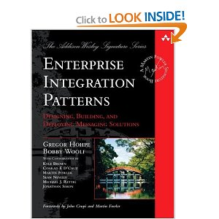
Further Reading
Enterprise Integration Patterns: Designing, Building, and Deploying Messaging Solutions
Gregor Hohpe
Bobby Woolf

Slide 16
Resources
MassTransit
Docs: http://docs.masstransit-project.com
Google Groups: http://groups.google.com/group/masstransit-discuss/
Chris Patterson: http://blog.phatboyg.com/
Dru Sellers: http://codebetter.com/drusellers/
Messaging/Distributed Systems
Udi Dahan: http://www.udidahan.com/
Martin Fowler – Patterns in Enterprise Software: http://www.martinfowler.com/articles/enterprisePatterns.html

Slide 17
Questions?

Slide 18
Thank You!
Github: https://github.com/ekepes
Twitter: @ekepes
Blog: http://erickepes.com
Email: ekepes@gmail.com
Demos and Slides:
https://github.com/ekepes/Presentations

